Slide 1
Following the Data, Not the Function: Rethinking Function Orchestration in Serverless Computing
Authors：Minchen Yu,Tingjia Cao, Wei Wang, Ruichuan Chen
Hong Kong University of Science and Technology,
University of Wisconsin-Madison,
Nokia Bell Labs
汇报人：何杭帅
2024年5月23日

Slide 2
提纲
研究背景
系统设计
实验评估
工作总结

Slide 3
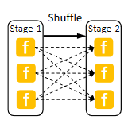
研究背景
· Serverless computing is becoming increasingly popular in the cloud
· Many applications have recently been migrated to the severless cloud
· These applications typically consist of multiple interactive functions
with diverse function-invocation and data-exchange patterns.
Hundreds of parallel functions
for all-to-all data communication
in a shuffle phase.
E.g. A serverless-based batch analytics application

Slide 4
研究背景
Wanted
An expressive，efficient and easy-to-use
function orchestration
×
×
However
Function orchestration in current serverless platforms
Typically models a serverless application as a workflow that connects functions according to their invocation dependency

Slide 5
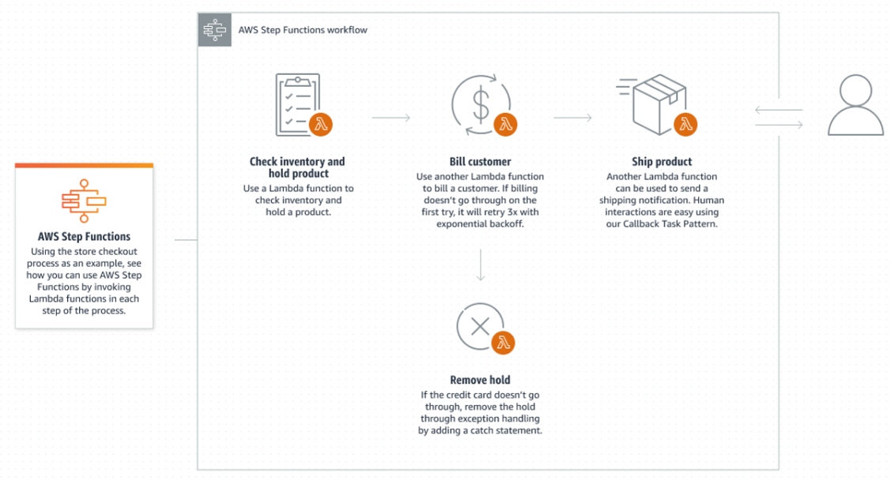
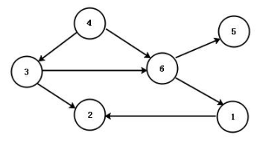
研究背景
Workflow
· Runs on functions that call each other and depend on each other
· Each function need be triggered upon the completion of one or multiple
upstream functions
abstract
modelling

Slide 6
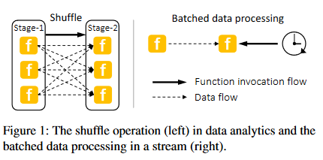
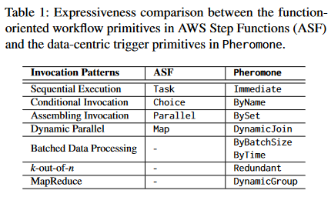
研究背景
Problem One
· Limited expressiveness.
Assumes :
The output of a function is entirely and immediately consumed by the next function

Slide 7
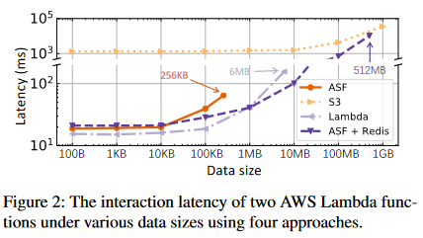
研究背景
Problem Two
· Limited usability.
Various options for data exchange :
Via a message broker/a sharedstorage
(synchronously/asynchronously)
Message came from:
Nested function calls;
Message queues;
Other cloud services
Lacks :
One approach is optimal in all scenarios

Slide 8
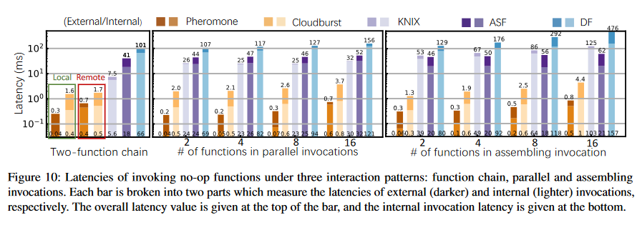
研究背景
Problem Three
One fatal flaw ( for a specific application ) :
Existing serverless applications are typically not latency-sensitive
· Limited applicability.
In addition :
Existing serverless applications are ill-suited for data-intensive applications

Slide 9
系统设计
A novel data-centric approach
Key Insight : data-centric
Breaks the tight coupling between function flows and data flows.
Provides a unified programming interface for both function invocations and data exchange.
Knowing when and how the intermediate data will be consumed , so serverless platform scheduler can optimize the locality of functions and relevant data.
Data can be consumed with fine-grained control, so rich workflow patterns can be expressed
No need to implement complex logic through a large combination of external services
Latency-sensitive and data-intensive applications can be supported efficiently

Slide 10
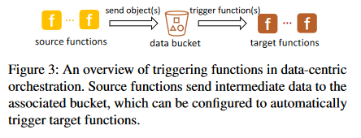
系统设计
Operational foundations for a data-centric Serverless platform
Data Bucket
Trigger Primitives
Dynamic trigger primitives :
Direct trigger primitive :
Allows one or more functions to directly consume data in the associated buckets
Conditional trigger primitives :
DynamicJoin
DynamicGroup
ByBatchSize
ByTime
ByName
BySet
Redundant

Slide 11
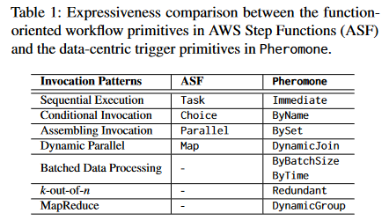
系统设计
Operational foundations for a data-centric Serverless platform
Data Bucket
Trigger Primitives
Dynamic trigger primitives :
Direct trigger primitive :
Allows one or more functions to directly consume data in the associated buckets
Conditional trigger primitives :
DynamicJoin
DynamicGroup
ByBatchSize
ByTime
ByName
BySet
Redundant

Slide 12
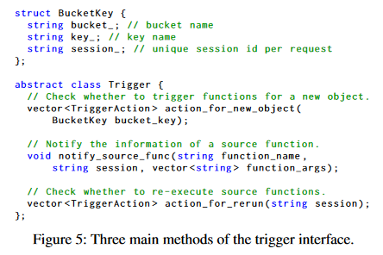
系统设计
Operational foundations for a data-centric Serverless platform
Data Bucket
Trigger Primitives
Abstract interface

Slide 13
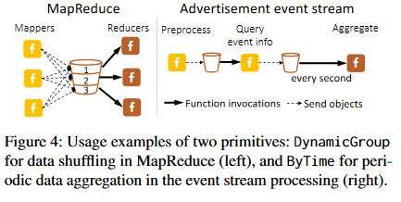
系统设计
Operational foundations for a data-centric Serverless platform
Programming Interface

Slide 14
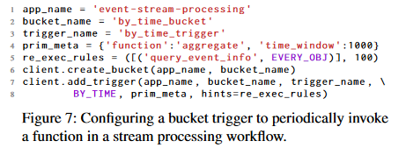
系统设计
Operational foundations for a data-centric Serverless platform
Programming Interface

Slide 15
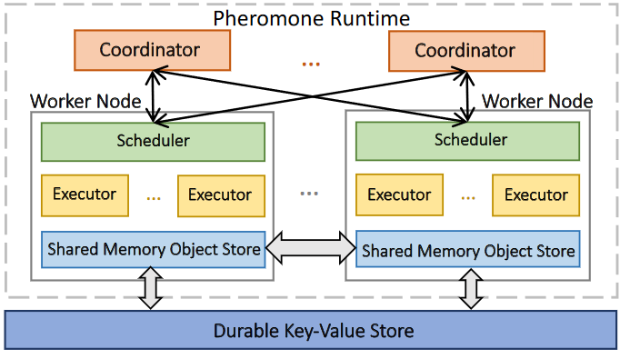
系统设计
Pheromone System Design
Architecture Overview
Scalable Distributed Scheduling
Fault Tolerance
Bucket Management and Data Sharing

Slide 16
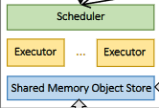
系统设计
Pheromone System Design
Scalable Distributed Scheduling
Intra-node scheduling & Delayed request forwarding from overloaded nodes.
Principles :
Invoke functions as locally as possible
Makes scheduling decisions based on the status of executors
Prioritizes those with function code already loaded to enable a warm start !
When the executor receives a request for the first time, it loads the function code from the local object store and persists it in memory for reuse in subsequent invocations

Slide 17
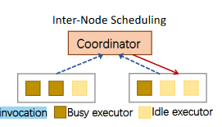
系统设计
Pheromone System Design
Scalable Distributed Scheduling
Inter-node scheduling
Drives the execution of a large workflow
decide to
trigger functions
Updates this message to relevant workers
reset local bucket status accordingly
Local schedulers reports :
Cached functions
Idle executor number
Number of objects relevant to the workflow

Slide 18
系统设计
Pheromone System Design
Scalable Distributed Scheduling
Scaling distributed scheduling with sharded coordinators.
Work flow 1
Work flow 2
Worker Node
Worker Node
Worker Node

Slide 19
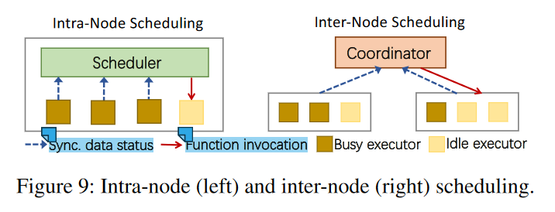
系统设计
Pheromone System Design
Bucket Management and Data Sharing
Bucket management
Remote key-value store
Shared Data Bucket

Slide 20
系统设计
Pheromone System Design
Bucket Management and Data Sharing
Fast data sharing
Key Insight :
Fully reap the benefits of data locality enabled by its datacentric design
Intermediate data objects has less need for data durability and consistency
Pheromone enables zero-copy data sharing between local functions by passing only the pointers of data objects to the target functions
A function packages the metadata (e.g., locator) of a data object into a function request being sent to a remote node.

Slide 21
系统设计
Pheromone System Design
Bucket Management and Data Sharing
Fast data sharing
Runs an I/O thread pool on each worker node
Data-centric design
Expose details of intermediate data
Big Data
Small Data
Sent as raw byte arrays
Sent as being piggybacked
as a small object

Slide 22
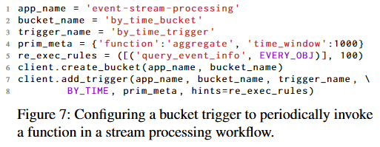
系统设计
Pheromone System Design
Fault Tolerance
Cases:
Response:
An executor fails or a data object is lost
Restarts the failed function to reproduce the lost data and resume the interrupted workflow
The expected output has not been received in a configurable timeout
Using the data bucket to re-execute its source function
Benefit:
Simplify the scheduling logic
Allows developers to customize function re-execution rules when configuring data buckets

Slide 23
提纲
研究背景
系统设计
实验评估
工作总结
Answers three questions:
• How does Pheromone improve function
interactions and ensure high scalability?
• Can Pheromone effectively handle failures?
• Can developers easily implement real-world
applications with Pheromone and deliver high
performance?

Slide 24
实验评估-实验设置
Cluster settings：
EC2 Cluster Deployment
Coordinators:
Instance Type: c5.xlarge
vCPUs: 4
Memory: 8 GB
Worker Nodes:
Instance Type: c5.4xlarge
vCPUs: 16
Memory: 32 GB
Executors: Configurable (Tuned per experiment)
Scale:
Coordinators: Up to 8
Worker Nodes: Up to 51
Location: us-east-1a EC2 zone

Slide 25
实验评估-实验设置
Baseline Comparison:
Cloudburst：
Open-source platform
Early binding scheduling
Function-collocated caches
Deployment: Same configuration as Pheromone
Azure Durable Functions (DF)：
Flexible function interaction support
Entity Functions for state management
KNIX：
Evolution of SAND
In-container process execution
Local/remote data sharing
AWS Step Functions (ASF)：
Uses ASF Express Workflows
Redis for large data sharing
Configuration Notes:
Function instances and executors matched across platforms
Resources allocated consistently
All functions pre-warmed to prevent cold starts

Slide 26
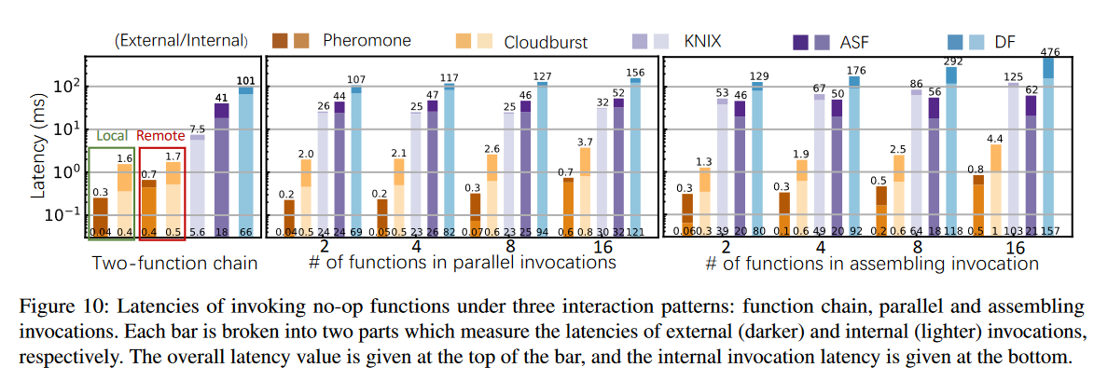
实验评估-Function Interaction
Function invocation under various patterns
Overhead of invoking no-op functions without any payload
The average latency over 10 runs

Slide 27
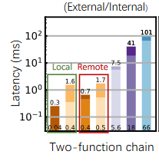
实验评估-Function Interaction
Compare in five platforms
Reducing the local invocation latency to 40 μs
10× faster than Cloudburst.
140× over KNIX
450× over ASF
The invocation latencies of a twofunction chain

Slide 28
实验评估-Function Interaction
Compare in five platforms
Evaluate the cross-node function invocations in Pheromone and Cloudburst by configuring 12 executors on each worker, thus forcing remote invocations when running 16 functions.

Slide 29
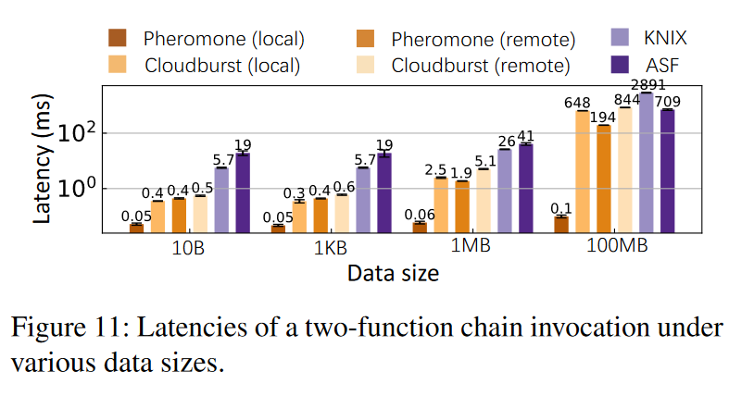
实验评估-Function Interaction
Data transfer
Interaction overhead when transferring data between functions.

Slide 30
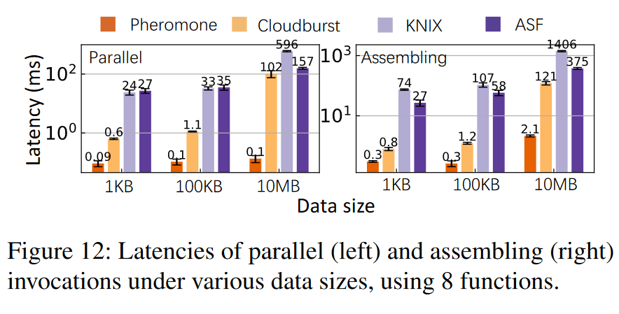
实验评估-Function Interaction
Data transfer
Starting with the transmission of the first object
Interaction overhead when transferring data between functions.
Ending with the reception of all objects in the assembly function
Starting with the call to the parallel downstream function
Ending with passing data to all functions

Slide 31
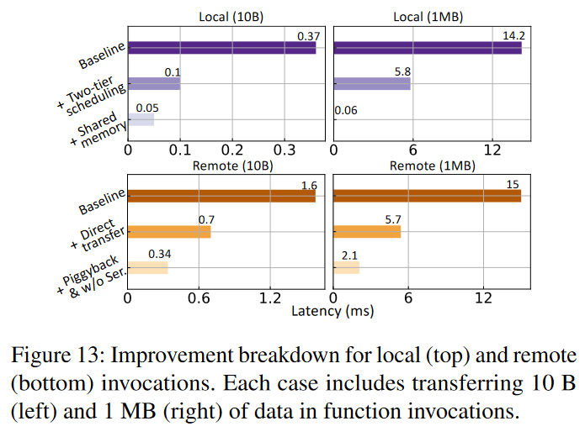
实验评估-Function Interaction
Improvement breakdown
Break down Pheromone’s function invocation performance
Only use a central coordinator to in-voke downstream functions
Uses a durable key-value store

Slide 32
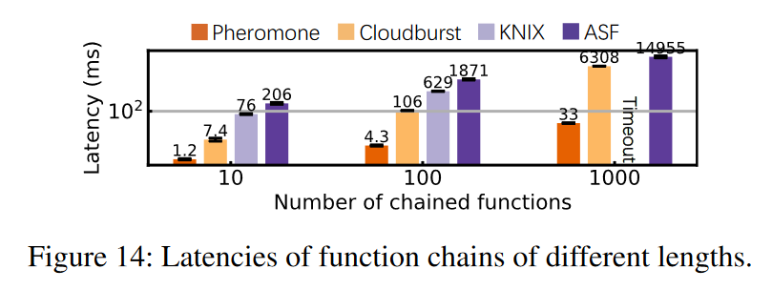
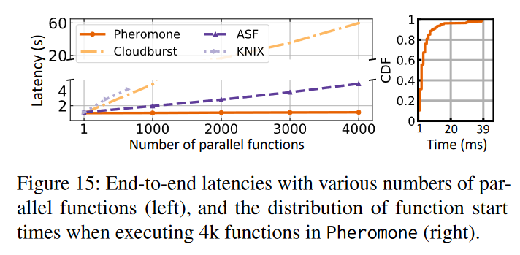
实验评估-Scalability
Internal function invocations
Long function chain
Parallel functions

Slide 33
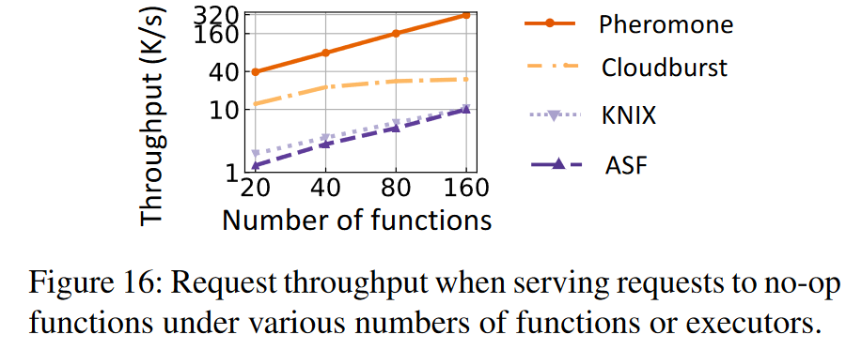
实验评估-Scalability
External user requests.
User request throughput

Slide 34
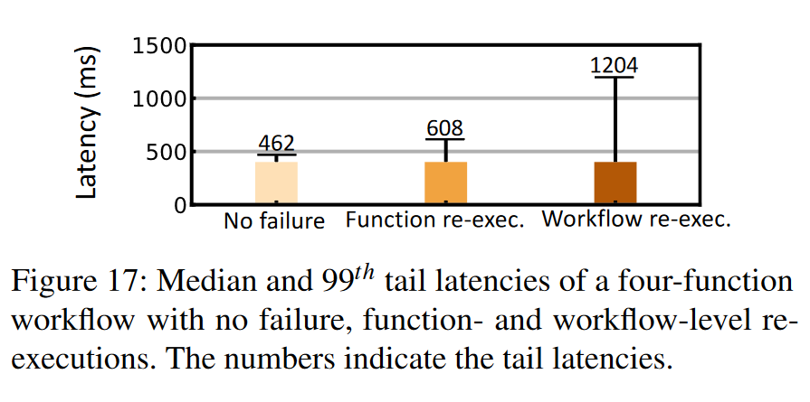
实验评估-Fault Tolerance
Time.sleep
Time.sleep
Time.sleep
Time.sleep

Slide 35
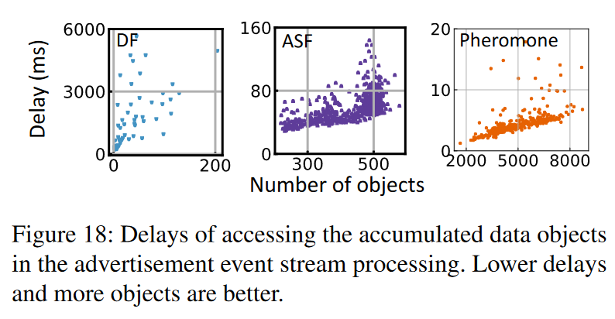
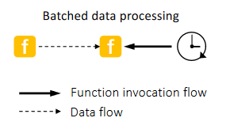
实验评估-Case Studies
Advertisement event stream processing

Slide 36
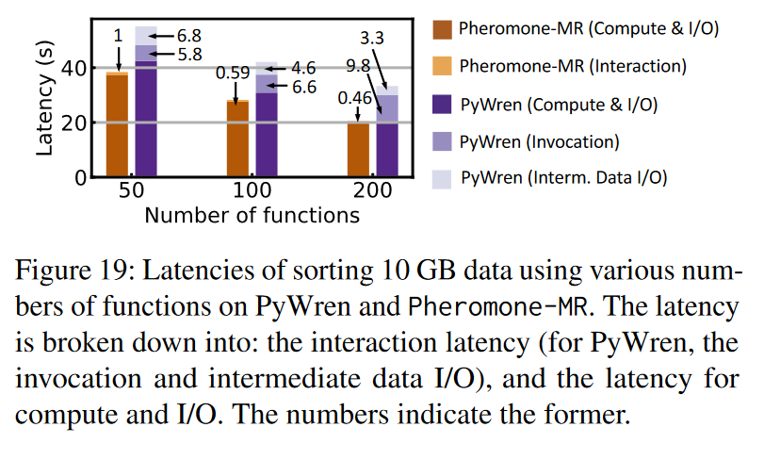
实验评估-Case Studies
MapReduce sort

Slide 37
提纲
研究背景
系统设计
实验评估
工作总结

Slide 38
总结
Pheromone：
总体上：
Revisits the function orchestration in serverless computing,
designed and developed a data-centric platform.
设计上：
Use data bucket & trigger primitives , break the tight coupling between function flows and data flows. (Thinking and programming)
Designed a system based on shared memory and two-tier slice schedulingn.
(Architecture, communication mechanisms)
实验上：
Compare vs 4 platforms , test the overhead. ( To prove truly improve function interactions)
Testing in the event of a possible crash. ( To prove system tolerance)
Selected real cases to do some test. ( To prove platform can easily implement real-world applications)

Slide 39
Q&A

